Slide 1
Data Analysis of Jurkat γδ+ Reporter Lines for GMP Seed Clones
Davit Sargsyan and Jocelyn Sendeki
For Maggie Emrich Last Updated: 9/13/2024

Slide 2
Background and Study Design
Effector (E) cell expresses gamma-delta T-cell receptors
Target (T) cell, Daudi: B lympoblast cell line (lymphoma CD19+ cells)
gdTCR: gamma-delta T-cell receptor
Butyrophilins (BTN): gdTCR ligand
ZOL: aka zoledronic acid, an antiresorptive medication inhibits bone degeneration. 24-h pretreatment of Daudi with ZOL. Untreated = no ZOL.
PMA/Ionomycin: ???
Unstimulated means no Daudi cells in the culture, Jurcat only. I.e., Daudi stimulates Jurkat to get activated.
TCR Clone = Daudi or Daudi+ZOL means no Jurcat cell in the culture.
24h co-culture of Jurcat -Daudi with Jurcat x4 titrations (E:T from 4:1 to 1:16)
Assuming that all gdTCR constructs activate the effector cells the same way
Each of the 28 clones came from an individual patient
Effector (T-cell)
Target (B-cell)
ZOL
CDR3-gamma arm
Jurkat
Artificial Report
System
Daudi
Cancer Cell
gdTCR
BTN-3
CDR3-delta arm
24h E:T co-culture
Jurcat stimulation by Daudi and
activation
BTN-3 receptor becomes V-shaped after ZOL treatment

Slide 3
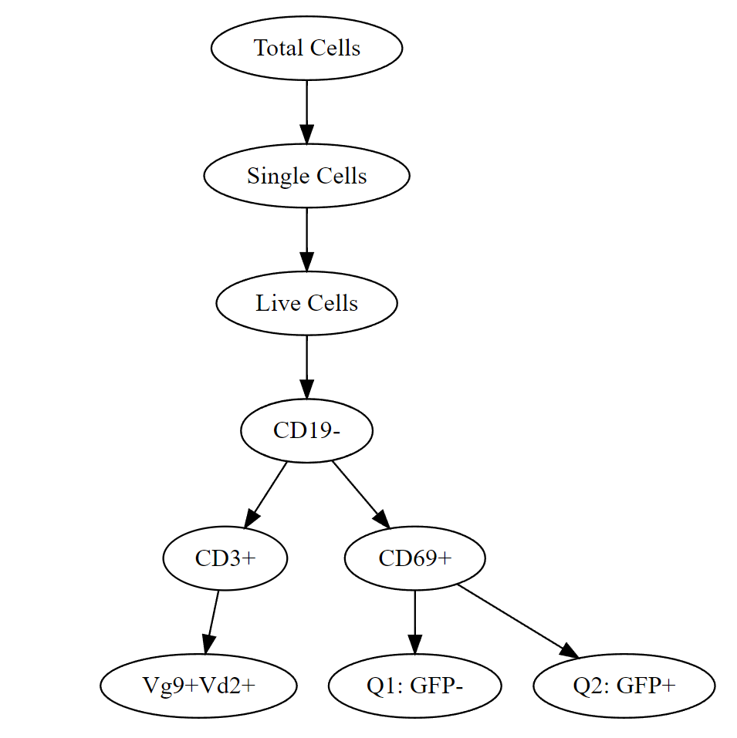
Gating Strategy
Total Cells
Singlets
Live Cells
Gates
Vγ9+Vδ2+
CD3+
CD19-
Activation
NOTE: CD69+ and CD3+ are not mutually exclusive! The tree should show them as overlapping ovals.

Slide 4
Counts

Slide 5
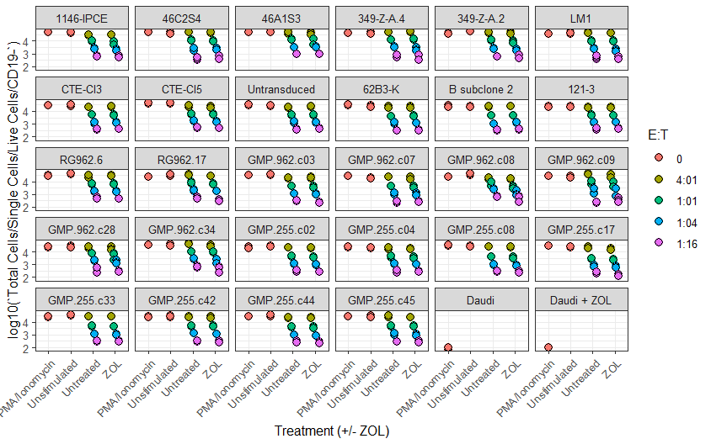
Counts of CD19- Cells (10^x), i.e. Jurkats Only
CD19 is a B-cell marker.
Since there are only 2 types of cells in the co-culture (Jurkat T-cells and Daudi B-cells), CD19- population is the Jurkats.
CD3 and Vγ9Vδ2 areT-cell marker.
There are always same number of Daudis present (20k?), and Jurkats are titrated (E:T=4:1 means 80k Jurkats and 20k Daudis, 1:1 means 20k each, etc.).
The number of live Jurkats varies for different constructs. E.g.,:
In E:T=1:1, Jurkat count was in the range of 2.5k-13k
In E:T=4:1, Jurkat count was in the range of 16k-50k in Untreated, and 2.5k-13k in ZOL
In Unstimulated samples (Jurkat cells only), the number of Jurkats varied 20k-56k

Slide 6
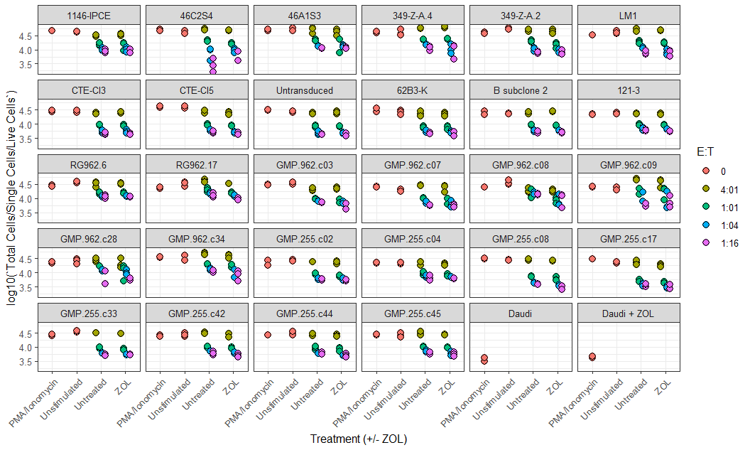
Counts of Live Cells (10^x)

Slide 7
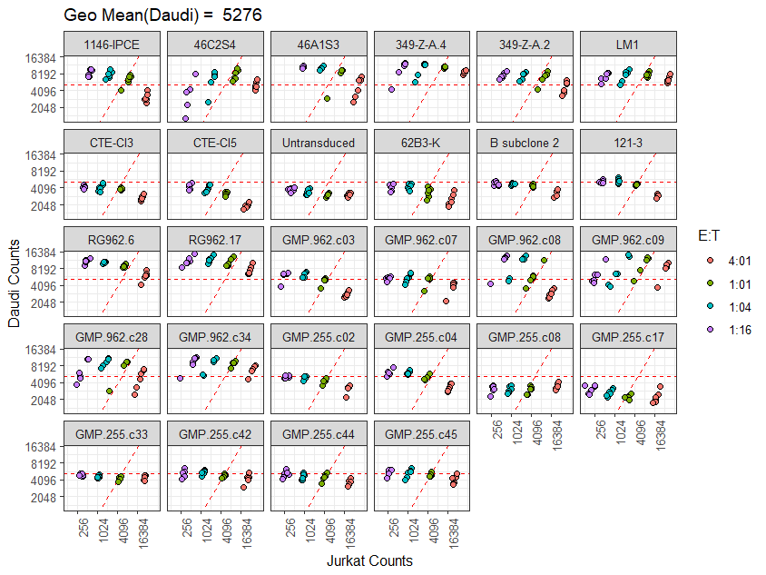
Counts of CD19- (Jurkat) vs CD19+ (Daudi) Cell Counts
With Geometric Mean of Daudies
Red horizontal dashed line is the geometric mean of Daudies in all samples combined
Red diagonal dashed line is the equality of Jurcat (CD19-) and Daudi (Live – CD19-) cells.
For most gdTCR clones the equality achieved at around the average number of Daudies, i.e., somewhere around 5,000 cells of each type.
In some clones, both counts are elevated in the E:T=1:1 samples (eg, 349-Z-A.4).
Others have low counts for both(eg, GMP.255.c17)
Many clones show strong negative correlation between Jurkats and Daudies (eg, 1146-IPCE). Are Daudies being killed by/in the presence of Jurcats? Is this just a competition for resources?
Was the starting number of Daudies 20k in all samples?

Slide 8
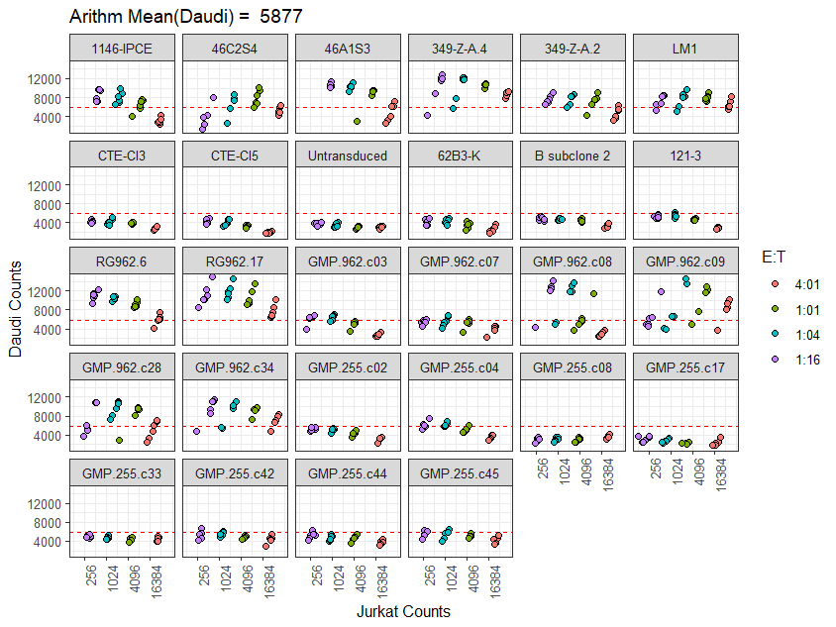
Counts of CD19- (Jurkat) vs CD19+ (Daudi) Cell Counts
With Arithmetic Mean of Daudies and the Linear Slopes
TCR Clone Name | Slope (Log2/Log2) | pValue
1146-IPCE | -0.173 | <0.001
46C2S4 | -0.012 | 0.647
46A1S3 | -0.109 | 0.000
349-Z-A.4 | -0.031 | 0.163
349-Z-A.2 | -0.063 | 0.001
LM1 | -0.019 | 0.204
CTE-Cl3 | -0.065 | <0.001
CTE-Cl5 | -0.090 | <0.001
Untransduced | -0.022 | 0.016
62B3-K | -0.068 | 0.001
B subclone 2 | -0.063 | <0.001
121-3 | -0.126 | <0.001
RG962.6 | -0.166 | <0.001
RG962.17 | -0.116 | <0.001
GMP.962.c03 | -0.174 | <0.001
GMP.962.c07 | -0.062 | 0.007
GMP.962.c08 | -0.433 | 0.001
GMP.962.c09 | 0.049 | 0.324
GMP.962.c28 | -0.099 | 0.165
GMP.962.c34 | -0.050 | 0.083
GMP.255.c02 | -0.086 | <0.001
GMP.255.c04 | -0.152 | <0.001
GMP.255.c08 | 0.021 | 0.025
GMP.255.c17 | -0.018 | 0.237
GMP.255.c33 | -0.005 | 0.516
GMP.255.c42 | -0.034 | 0.022
GMP.255.c44 | -0.050 | 0.001
GMP.255.c45 | -0.049 | 0.002

Slide 9
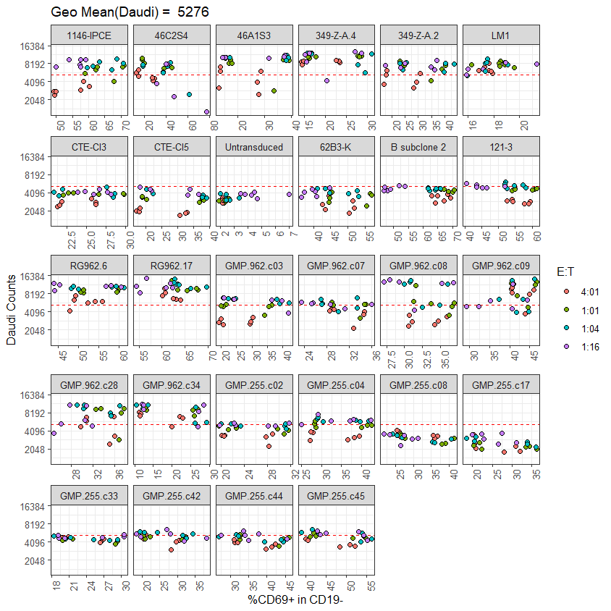
Proximal (Upstream) Activation of Jurkat (%CD69+ in CD19-) vs CD19+ (Daudi) Cell Counts with Geometric Mean of Daudies
Red horizontal dashed line is the geometric mean of Daudies in all samples combined
69+ marker indicates proximal (upstream) activation of Jurkat cells
Only a few clones show negative correlation between % activated Jurkats and number of live Daudi cells in the sampls. E.g., GMP255.c08 and .c17.

Slide 10
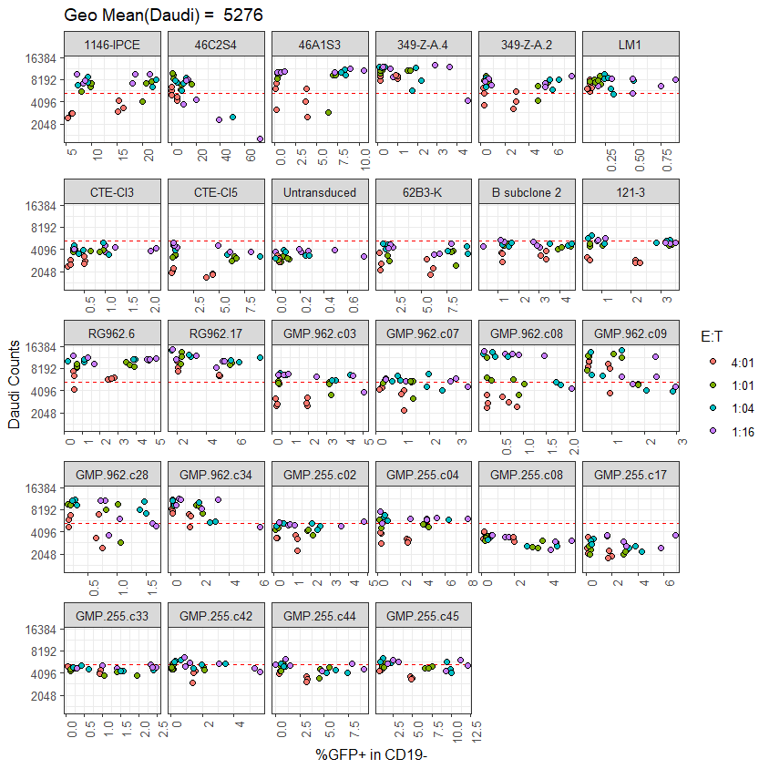
Distal (Downstream) Activation of Jurkat (%GFP+ in CD19-) vs CD19+ (Daudi) Cell Counts with Geometric Mean of Daudies
Red horizontal dashed line is the geometric mean of Daudies in all samples combined
GFP+ marker indicates distal (downstream) activation of Jurkat cells
Only a few clones show negative correlation between % activated Jurkats and number of live Daudi cells in the sampls. E.g., GMP255.c08.

Slide 11
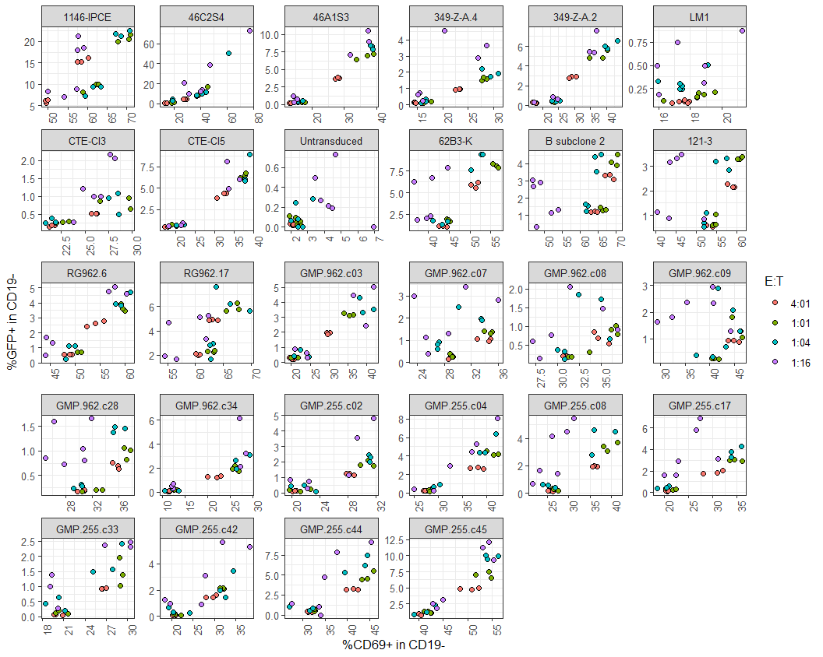
Proximal (Upstream, CD69+ in CD19-) vs Distal (Downstream, %GFP+ in CD19-) Activation of Jurkat Cells
The two measurements were positively correlated but not in all clones

Slide 12
Clone Heatmaps and Clustering of Cell Counts

Slide 13
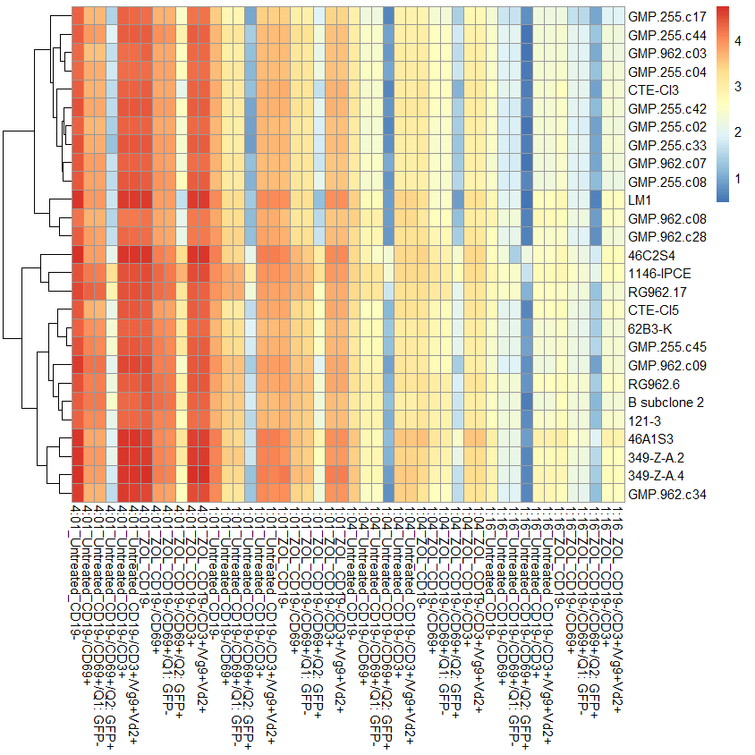
Cell Count Heatmap and clustering of TCR clones
Counts data was log10-transformed (+1)
Log10 counts were averaged per treatment (Untreated and ZOL), E:T ration (4:1, 1:1, 1:4 and 1:16) and gate (CD19-, CD69+, GFP+, GFP-, CD3+ and Vg9+Vd2+)
Heatmap colors represent means of the Log10 value magnitude. E.g., value of 3 = 10^3 (1,000 cells)
Dendrograms are graphical representations of hierarchical clustering of clones (Y-axis) and subgroups (X-axis)
Results:
Most GMP clones had similar profiles (top red box)
46C2S4, 1146-IPCE and RG962.17 had similar profiles (2nd red box)

Slide 14
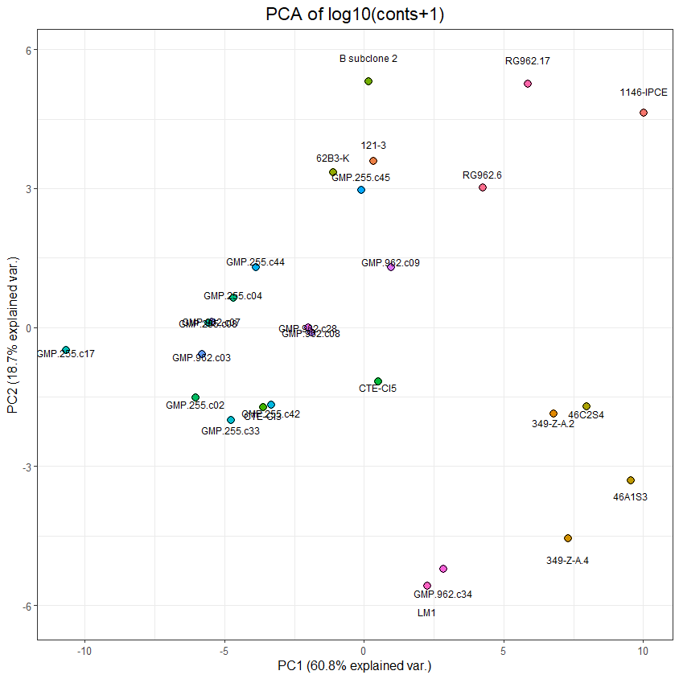
Cell Count PCA and clustering of TCR clones
Counts data was log10-transformed (+1)
Log10 counts were averaged per treatment (Untreated and ZOL), E:T ration (4:1, 1:1, 1:4 and 1:16) and gate (CD19-, CD69+, GFP+, GFP-, CD3+ and Vg9+Vd2+)
Principal components analysis (PCA) was used to represent the 27 clones in a 2D projection (from 48 features constructed from combinations of treatments, E:T ratios and gates, as in the heatmap on the previous page)
Results:
1146-IPCE , RG962.17 and RG962.6 had similar profiles (top red circle)
Most GMP clones clustered together (left red circle)
Clones 46xx and 349xx clustered together (bottom red circle)

Slide 15
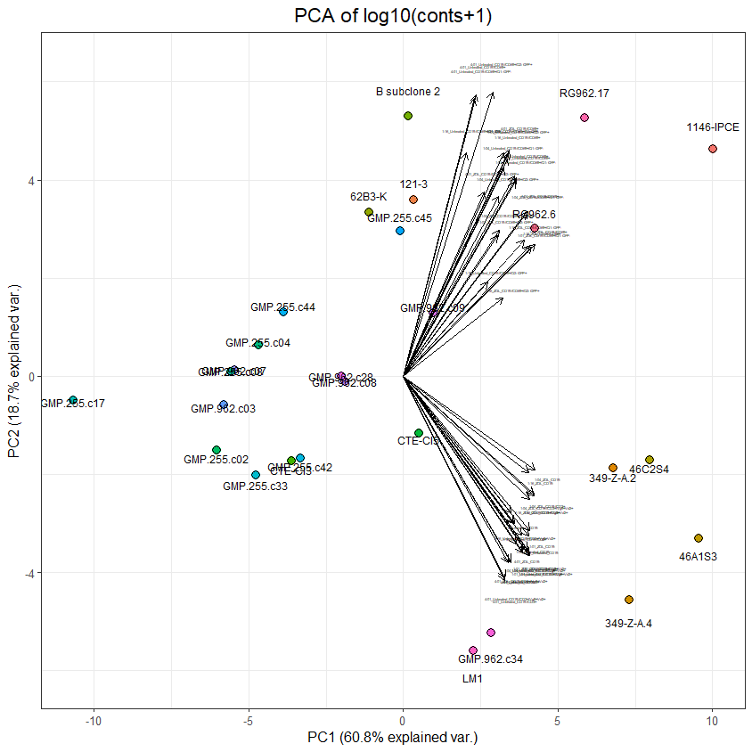
Cell Count PCA and clustering of TCR clones biplot
Differentiation between the top and the bottom right clusters is along PC2, therefore features with positive signs are increased in the top cluster, and the ones with negative signs are increased in the bottom cluster clones:
Features contributing to top cluster | PC2 | Features contributing to bottom cluster | PC2
4:01_Untreated_CD19-/CD69+/Q2: GFP+ | 0.2317 | 1:04_ZOL_CD19- | -0.0763
4:01_Untreated_CD19-/CD69+ | 0.2294 | 1:16_ZOL_CD19- | -0.0785
4:01_Untreated_CD19-/CD69+/Q1: GFP- | 0.2263 | 1:04_ZOL_CD19-/CD3+ | -0.0960
4:01_ZOL_CD19-/CD69+ | 0.1841 | 1:04_ZOL_CD19-/CD3+/Vg9+Vd2+ | -0.0971
1:16_Untreated_CD19-/CD69+/Q1: GFP- | 0.1821 | 1:16_ZOL_CD19-/CD3+/Vg9+Vd2+ | -0.1001
4:01_ZOL_CD19-/CD69+/Q1: GFP- | 0.1820 | 1:16_ZOL_CD19-/CD3+ | -0.1006
1:01_Untreated_CD19-/CD69+/Q2: GFP+ | 0.1817 | 1:16_Untreated_CD19- | -0.1113
1:16_Untreated_CD19-/CD69+ | 0.1774 | 1:16_Untreated_CD19-/CD3+/Vg9+Vd2+ | -0.1196
1:04_Untreated_CD19-/CD69+/Q1: GFP- | 0.1696 | 1:16_Untreated_CD19-/CD3+ | -0.1200
1:04_Untreated_CD19-/CD69+ | 0.1635 | 1:01_ZOL_CD19- | -0.1256
1:01_Untreated_CD19-/CD69+ | 0.1621 | 1:04_Untreated_CD19- | -0.1296
1:01_Untreated_CD19-/CD69+/Q1: GFP- | 0.1588 | 1:01_Untreated_CD19- | -0.1304
4:01_ZOL_CD19-/CD69+/Q2: GFP+ | 0.1504 | 4:01_ZOL_CD19- | -0.1364
1:04_Untreated_CD19-/CD69+/Q2: GFP+ | 0.1467 | 1:01_ZOL_CD19-/CD3+ | -0.1417
1:04_ZOL_CD19-/CD69+ | 0.1342 | 1:01_ZOL_CD19-/CD3+/Vg9+Vd2+ | -0.1421
1:04_ZOL_CD19-/CD69+/Q1: GFP- | 0.1333 | 1:04_Untreated_CD19-/CD3+ | -0.1434
1:04_ZOL_CD19-/CD69+/Q2: GFP+ | 0.1192 | 1:04_Untreated_CD19-/CD3+/Vg9+Vd2+ | -0.1434
1:01_ZOL_CD19-/CD69+/Q2: GFP+ | 0.1146 | 1:01_Untreated_CD19-/CD3+/Vg9+Vd2+ | -0.1457
1:16_ZOL_CD19-/CD69+/Q1: GFP- | 0.1107 | 1:01_Untreated_CD19-/CD3+ | -0.1458
1:01_ZOL_CD19-/CD69+ | 0.1074 | 4:01_ZOL_CD19-/CD3+/Vg9+Vd2+ | -0.1510
1:16_ZOL_CD19-/CD69+ | 0.1062 | 4:01_ZOL_CD19-/CD3+ | -0.1518
1:01_ZOL_CD19-/CD69+/Q1: GFP- | 0.1052 | 4:01_Untreated_CD19- | -0.1518
1:16_Untreated_CD19-/CD69+/Q2: GFP+ | 0.0769 | 4:01_Untreated_CD19-/CD3+/Vg9+Vd2+ | -0.1643
1:16_ZOL_CD19-/CD69+/Q2: GFP+ | 0.0639 | 4:01_Untreated_CD19-/CD3+ | -0.1663

Slide 16
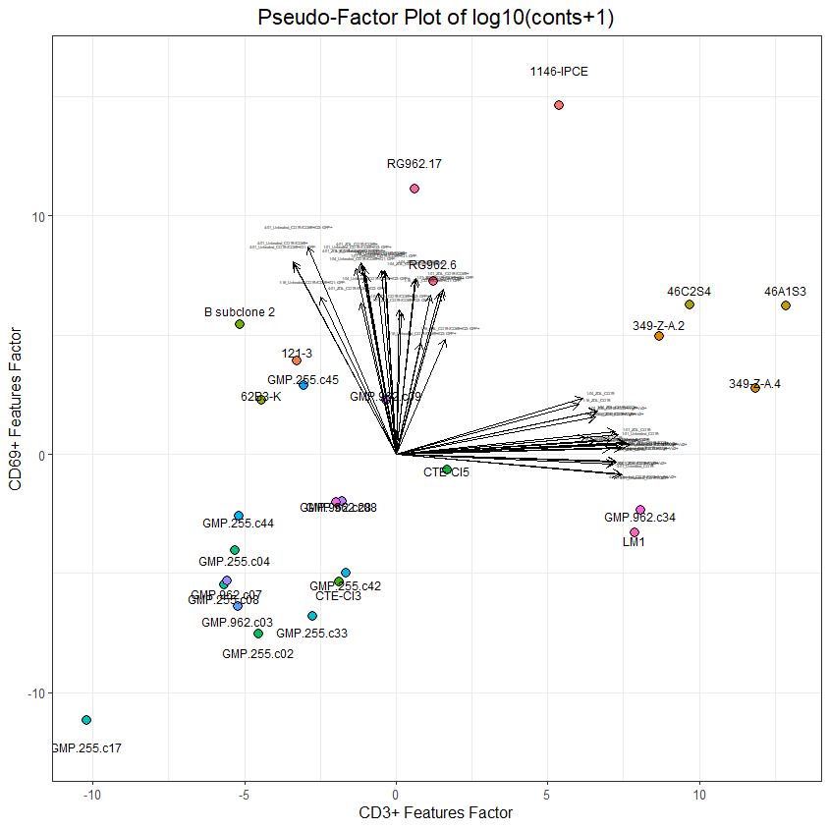
Cell Count PCA and clustering of TCR clones pseudo-factor plot
Previous figure rotated 45’ counterclockwise: CD69+ features increase toward the top, and CD3+ features increase toward the right side of the plot.

Slide 17
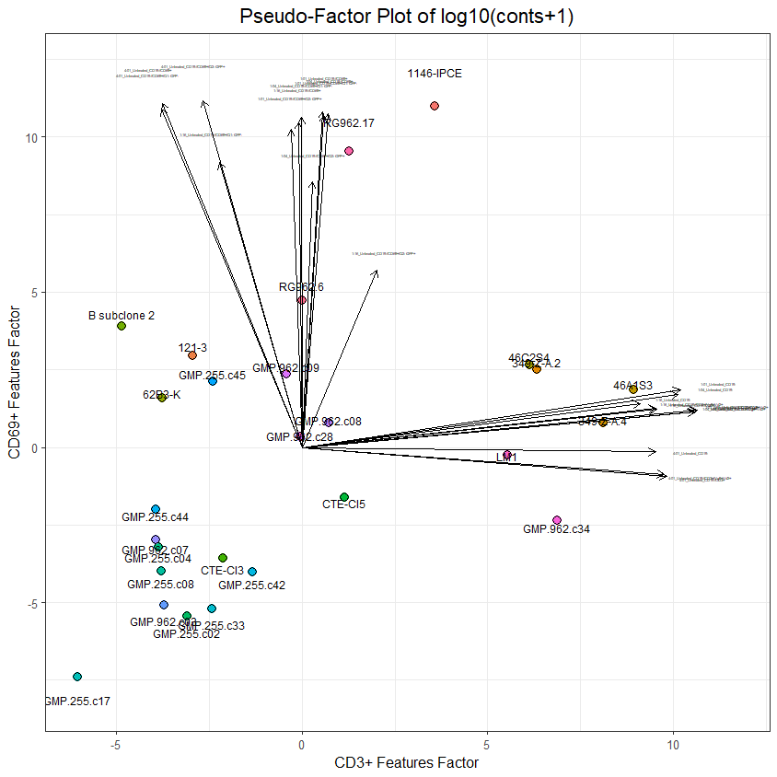
Cell Count PCA and clustering of TCR clones pseudo-factor plot
Untreated samples ONLY

Slide 18
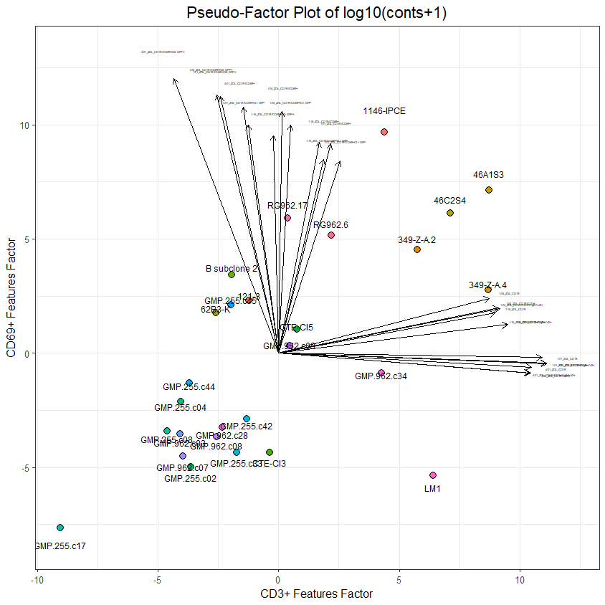
Cell Count PCA and clustering of TCR clones pseudo-factor plot
ZOL-treated samples ONLY
Observations:
In ZOL-treated samples, RG962.6 profile is much more similar to RG652.17 profile than it is in the Untreated samples
CD69 features also increase in the 46xx/349xx cluster

Slide 19
Continue Here

